Slide 1
Student Council Election Tally System
Problem Solving Using Java
Batch No: 4
Thummeti Teja-2620030003
Prakash Machgaiya-2620030067

Slide 2
Abstract:
The Student-Council election tally system makes voting and counting votes for school elections much easier. Using paper ballots by hand is time-consuming and it is easy to make mistakes. This Student-Council Election Tally System makes managing elections easier. Profiles can be made for candidates. Students can safely cast their votes. To keep things fair the student-council election tally system marks a voter account after they submit a ballot so that no one can vote twice. The student council election tally system also counts the votes automatically to find the totals right away. This student-council election tally system cuts down on paper ,stops counting mistakes and shows the results faster. It is built by using Java. It can grow to include things like encrypted logins.

Slide 3
Understanding Problem Statement:
The objective is to design and implement a software system that manages the voting process for a student council election.
Core Requirements:
Candidate Management: The system must allow an administrator to register candidates running for the election.
Vote Casting: Voters must be able to view the list of valid candidates and cast a single vote for their preferred choice.
Data Integrity: The system must validate inputs (e.g., preventing votes for non-existent candidates).
Tallying and Display: The system must maintain a live count of votes for each candidate and display the current standings when requested.
Result Declaration: At the end of the election, the system must calculate the highest number of votes, handle potential ties, and officially declare the winner(s).

Slide 4
CO1:
The method is the main method.
Scanner class has been used to know the number of students voting and the vote that each student casts.
Logical operators have been used to check conditions.

Slide 5
CO2:
While loop has been used to keep taking the vote from the students.
If-else conditional statements have been used.
For-loop has been used.

Slide 6
CO3:
1-D Array has been used to store the names of the participants and votes.
Methods StudentElectionTally and ShowResults have been used.StudentElectionTally has a return value but ShowResults does not.

Slide 7
CO-4
Constructor has been used to store two data pieces: Name and Votes
“this” keyword has been used.

Slide 8
CO-5:
Exception handling has been implemented through try-catch
String datatype has been used to store the names the participating candidates in the variable name
toUpperCase() method has been used to display the winner’s name in upper case letters

Slide 9
CO-6:
File Creation: new PrintWriter("results.txt") automatically creates a new text file (or overwrites it if it
already exists).
Text Writing: The PrintWriter object allows you to write plain text into the file using the f.write() method.

Slide 10
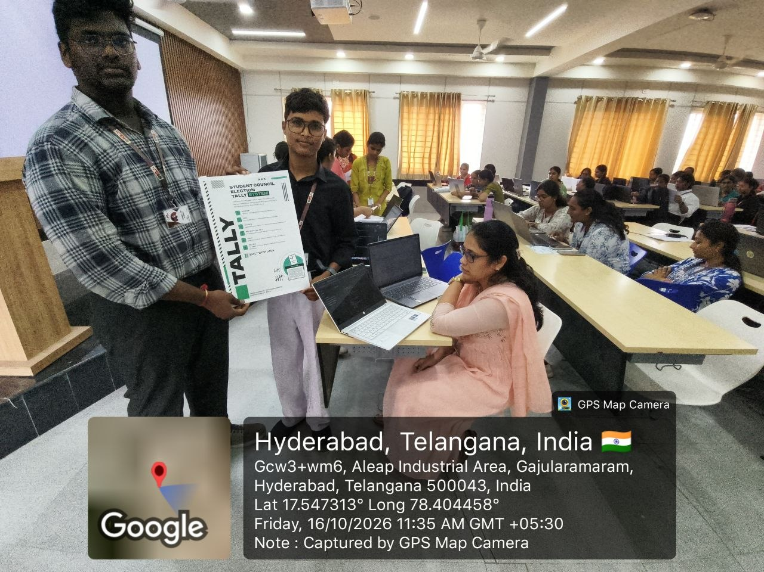
Git hub link- https://github.com/Teja5656/KLH-Bachupally-Y26-Batch-no.4-Student-Council-Election-Tally-System
Geo Tag Photo:

